Slide 1
CLEANED – Virtual Training June 22nd – July 3rd
Jessica Mukiri, An Notenbaert, Emmanuel Mwema, Birthe Paul, Rein Van der Hoek
cleaned@cgiar.org
CLEANED virtual training: 22/06/2020

Slide 2
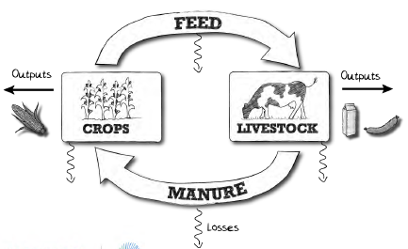
Welcome
Intro + Objectives - Jess
Maneuvering the MS Teams environment
Opening remarks – An, Birthe
Program overview
Introductions + Expectations
Start of the training

Slide 3



Objective
Understand the full functionality of the model.
Model different types of livestock enterprise systems (LES) using CLEANED.
Understand how to model a LES under different scenarios and explore the different impacts.

Slide 4

Overall Learning Outcomes
Describe the importance of carrying out environmental impacts assessments in the livestock sector.
Carry out CLEANED assessments in your day to day activities and be able to:
Calculate and gather valid input data needed for the model
Explain the calculations and parametrize the tool for a specific enterprise in a specific region
Carry out different intervention scenarios
Summarize, analysis CLEANED outputs needed for decision making.

Slide 5
Opening Remarks

Slide 6
Maneuvering the TEAMs environment + Introductions
Housekeeping rules
Understanding the environment, using the diff tabs, mic, polly tool
Notes:
Show pdf on housekeeping rules

Slide 7
Overview of Training
Agenda/Learning Outcomes
Texts & Materials
Assignments/Grading
Contact and office hours
Expectations
Notes:
Good to the actual. PDF, website and show this

Slide 8
Learning outcomes day 1
Identify the negative environmental impacts livestock growth has on the environment
Explain why we use environmental impacts assessments
List the environmental impacts that CLEANED assesses
Describe the different sections and processes in carrying out assessments in CLEANED

Slide 9
Part 1: Livestock and Environment

Slide 10



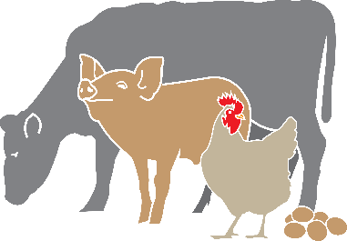


Why are Livestock is important: The facts
17
Food for at least
830 million
The value of livestock as a global asset reaches
USD3.1
BILLION
People exposed to food insecurity
17% of kilocalorie and 33% of protein consumption Vitamin A, B-12, riboflavin, calcium, iron and zinc.
TRILLION
The estimated total number of livestock worldwide
(including cattle, sheep, goats, pigs, chickens, and about a dozen lesser known species, like guinea fowl, yaks, and camels).
that accounts for some jobs
1.3 Billion
Notes:
https://livestockdata.org/data-object/exploring-landscape-livestock-facts
Livestock is important:
Employment, income
Economy
Food and nutrition
Cultural value
Resilience and risk management
Environment nutrient recycling

Slide 11
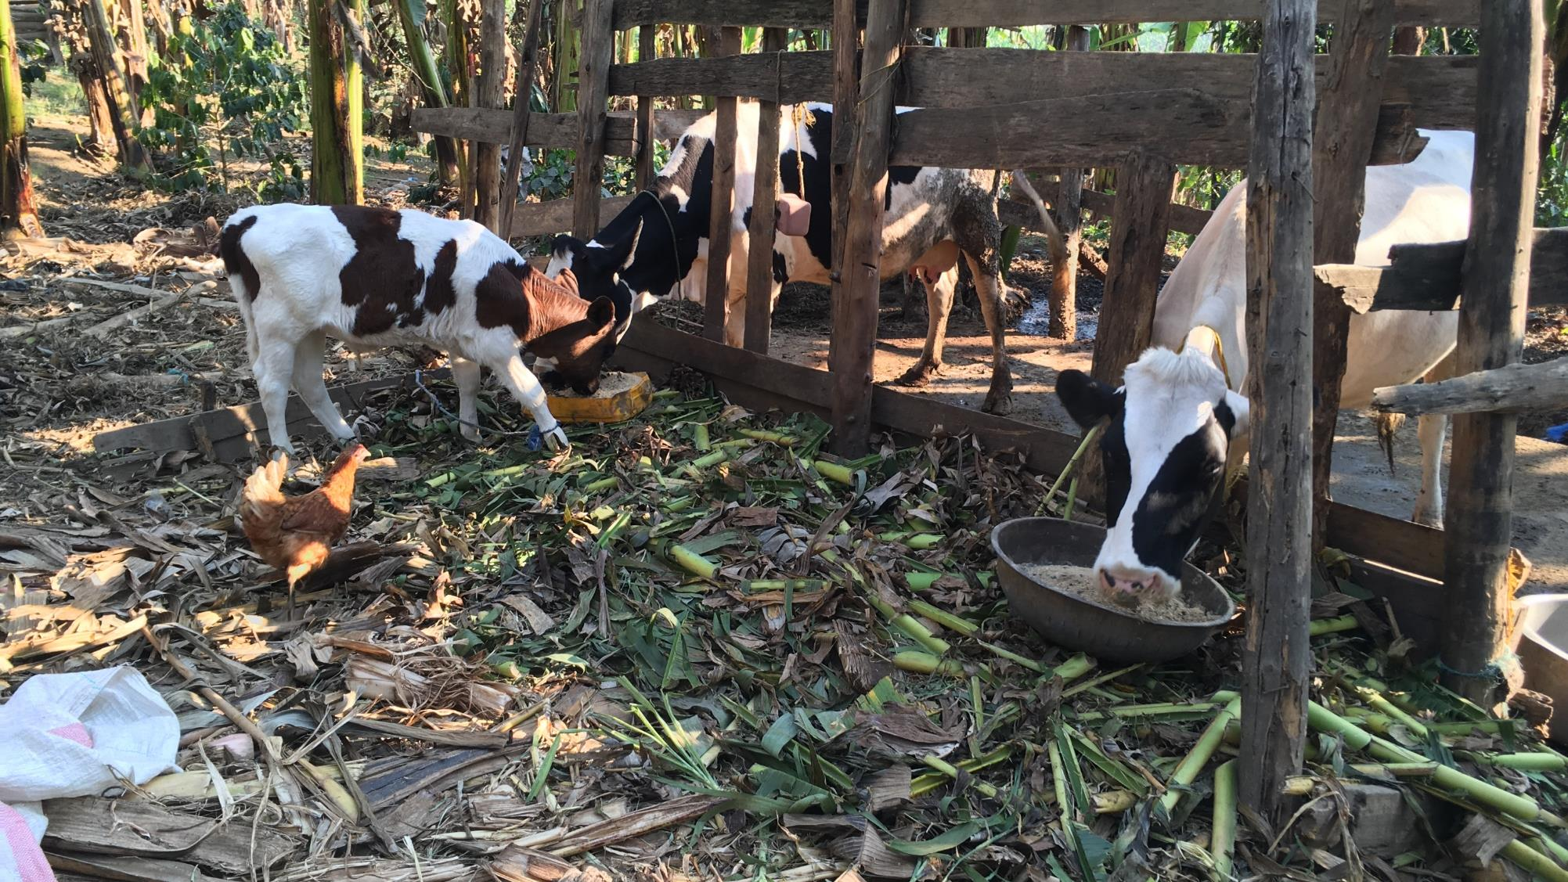
Rising demand of livestock products
Meat and milk in developing countries is predominantly produced in mixed crop-livestock systems, although productivity is still low.
Demand expected to double (2x) milk, 3x meat.
Population, Income, Urbanization , Globalization.

Slide 12











Current Environmental impacts
Herrero et al., (2013)
Negative environmental impacts:
EMISSIONS
LAND
of greenhouse gases
degradation and deforestation
WATER
DEFORESTATION
pollution and depletion
BIODIVERSITY
threatened
Notes:
Agricultural land: 70% used for livestock
Arable land: 40%
Fresh water: 8%
Loss of biodiversity, e.g through deforestation

Slide 13
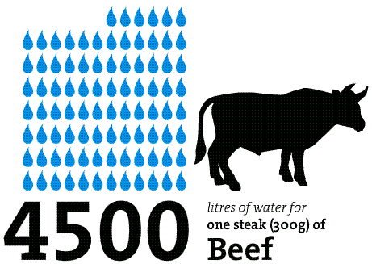
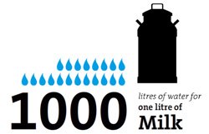
Water Footprint
Notes:
http://virtualwater.eu/

Slide 14
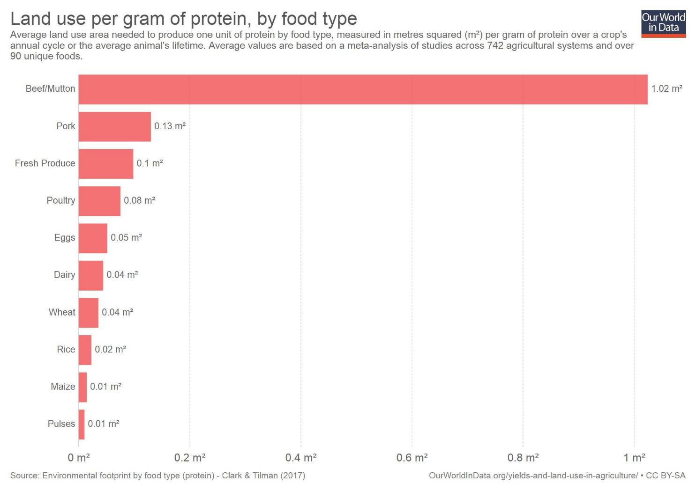
Notes:
https://ourworldindata.org/environmental-impacts-of-food#environmental-impacts-of-food-and-agriculture : quickly show the cite

Slide 15
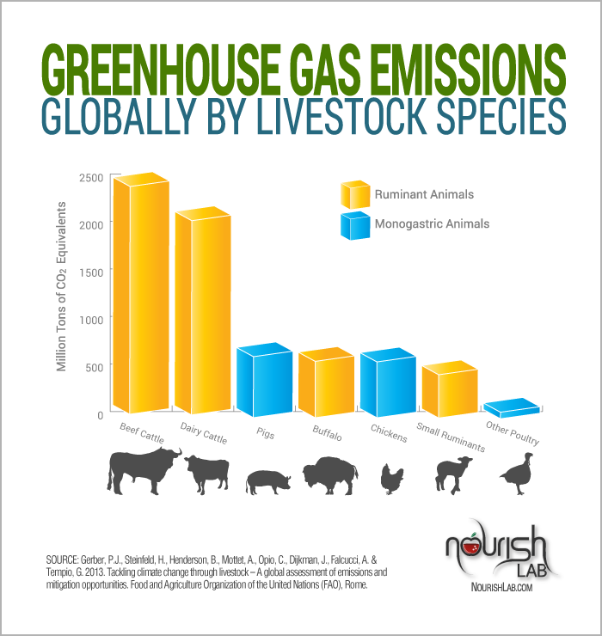
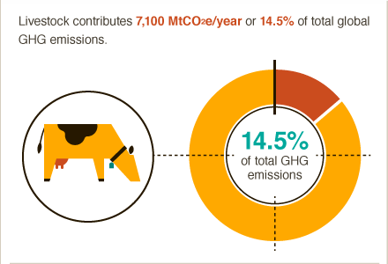
GHG Emissions
Notes:
https://ccafs.cgiar.org/bigfacts/#theme=food-emissions

Slide 16
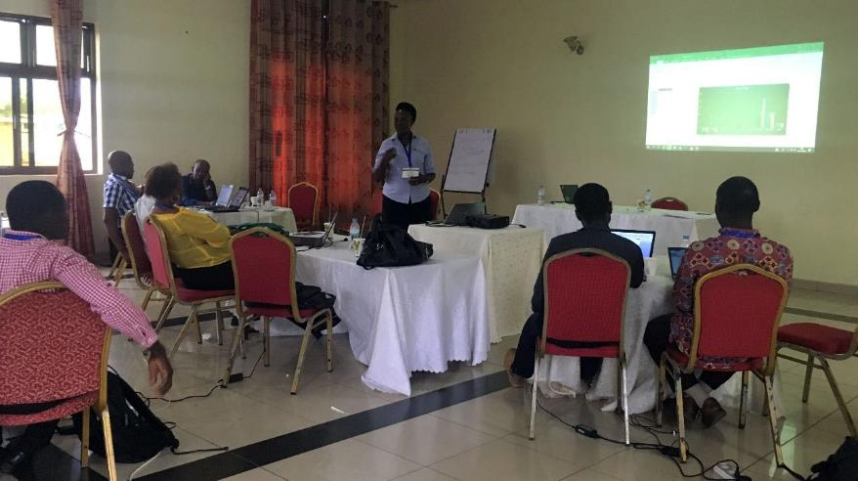
Breakout session 1
Discuss and rank from 1 to 5 (with 1 the most important and 5 the least important) the environmental impact dimensions in relation to livestock production in your country?

Slide 17
Country Coordinators Presentations

Slide 18
Part 2: CLEANED

Slide 19
What is CLEANED?
C omprehensive
L ivestock
E nvironmental
A ssessment for Improved
N utrition, a Secured
E nvironment and Sustainable
D evelopment along Livestock and Fish Value Chains.
“A rapid ex-ante environmental impact assessment tool that allows users to explore multiple impacts of developing livestock value chains.”
Notes:
The CLEANED tool or the “Comprehensive Livestock Environmental Assessment for Improved Nutrition, a Secured Environment and Sustainable Development along Livestock and Fish Value Chains” tool is a rapid ex - ante environmental impact assessment tool.
The CLEANED tool lets users explore multiple impacts of developing livestock value chains in explicit ways. It models the impact of intensifying livestock along multiple pathways;
greenhouse gas emissions, biodiversity loss, soil health and economic impact.
The CLEANED tool was developed to be used in ongoing innovation processes in value chains to support decisionmakers understanding of the environmental impacts of growth and develop more inclusive and sustainable livestock intensification plans that mitigate the negative impacts and enhance the positive ones.

Slide 20






What is CLEANED
The CLEANED tool lets users explore multiple impacts of developing livestock value chains in explicit ways. It models the impact of intensifying livestock along multiple pathways:
Land requirements
Productivity
Economics
Soil Impacts
Water impacts
GHG emissions
Notes:
The CLEANED tool or the “Comprehensive Livestock Environmental Assessment for Improved Nutrition, a Secured Environment and Sustainable Development along Livestock and Fish Value Chains” tool is a rapid ex - ante environmental impact assessment tool.
The CLEANED tool lets users explore multiple impacts of developing livestock value chains in explicit ways. It models the impact of intensifying livestock along multiple pathways;
greenhouse gas emissions, biodiversity loss, soil health and economic impact.
The CLEANED tool was developed to be used in ongoing innovation processes in value chains to support decisionmakers understanding of the environmental impacts of growth and develop more inclusive and sustainable livestock intensification plans that mitigate the negative impacts and enhance the positive ones.

Slide 21






The Architecture
Inputs Outputs Group
User
CLEANED tool
INPUT tab
Calculations
Back end calculations
(Multiple tabs)
Reports
Summary and individual
(Multiple tabs)
Parameter
Model parameters
(Multiple tabs)

Slide 22
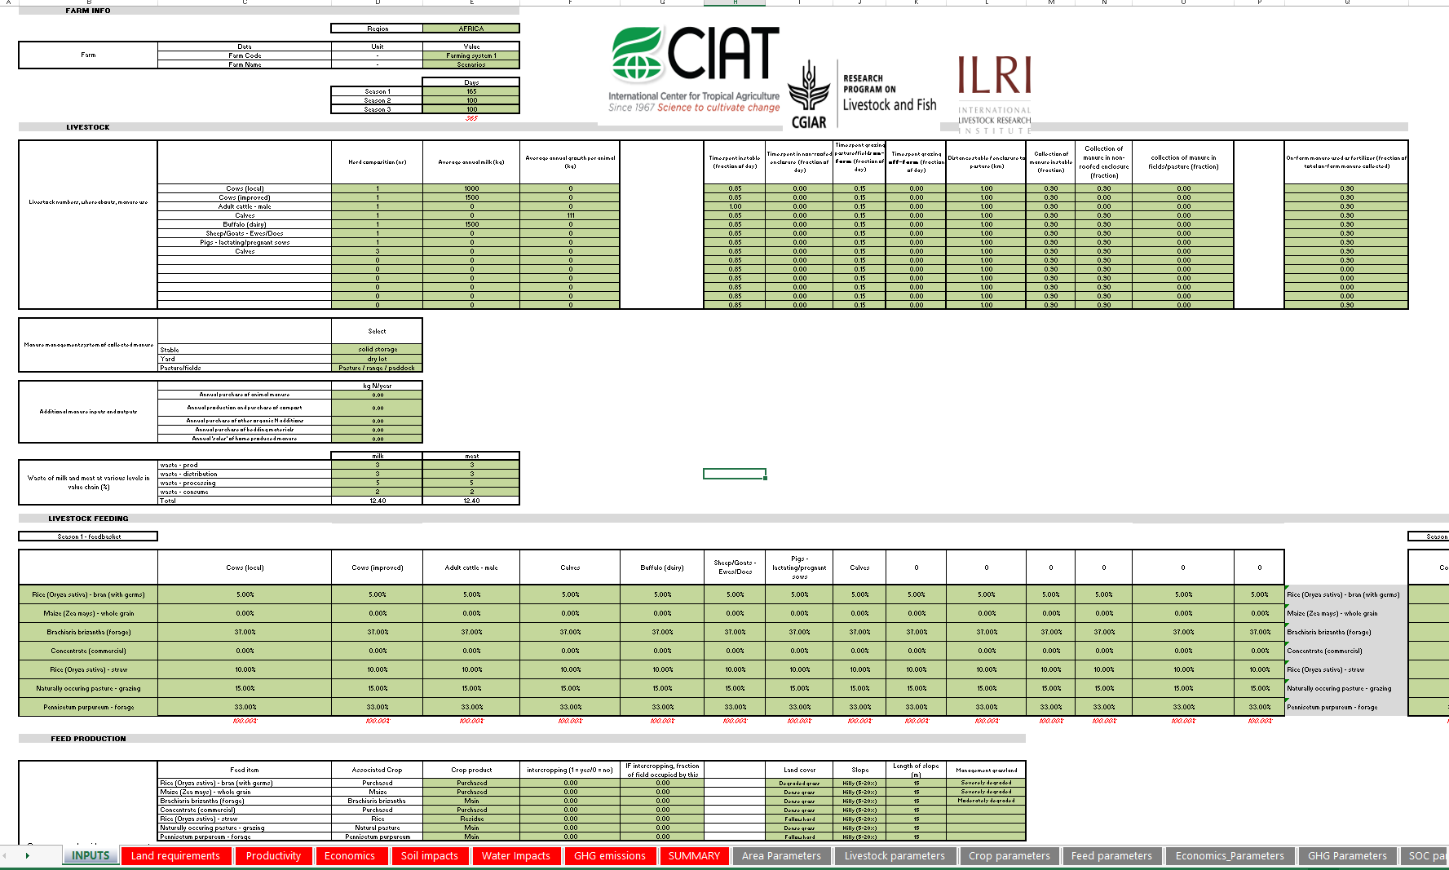

Slide 23

The process
The CLEANED tool process comprises of 2 stages:
Collect and input the baseline data
Generate reports for different scenarios of how the livestock production systems might change

Slide 24













Step 1
Location Define location
Livestock Describe system
Describe Practices e.g. grazing
Calculate environmental baselines
Step 2
Intervention 1
Describe interventions
Describe likely changes in inputs and parameters and
Calculate environmental impacts
Water
Land
Greenhouse gases
Economic
Intervention 2
Notes:
Second shows better economic as well
You won’t get all of them green and improved because to the realities of trade of environment, social and economic
So you should look to improve in a sustainable manner
5 minutes on creating alternative scenario

Slide 25
Quiz 1
Link to Quiz 1
https://forms.office.com/Pages/ResponsePage.aspx?id=AA76ahT6t0CKLiKn-MNX1aE1vfzSBf5GkjzzKvqgj8ZUMDJJMDFSNzc1TDlEWk1QTk40QzQ2NzhJNi4u

Slide 26
Assignment 1
Link to Assignment 1:
https://forms.office.com/Pages/ResponsePage.aspx?id=AA76ahT6t0CKLiKn-MNX1aE1vfzSBf5GkjzzKvqgj8ZUNkdKNTg4NUMyTjBPVlFXSFBIOUpGVVVCSC4

Slide 27
Pre-recorded material

Slide 28
Recap on what to do?

Slide 29
Thank you!
Jessica Mukiri, An Notenbaert, Emmanuel Mwema, Birthe Paul, Rein Van der Hoek
cleaned@cgiar.org
CLEANED virtual training: 22/06/2020

